Slide 1
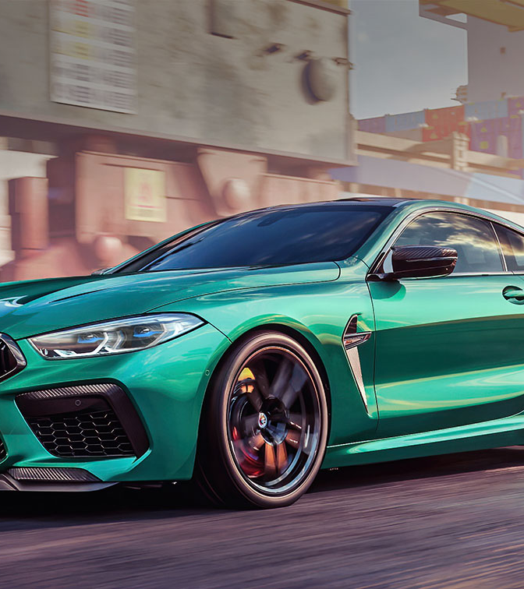
Vehicle Service & Maintenance Management System
Client – BookMyRepair
Submitted by: Group 5
Jeo Yesudas
Vamshi Kurra
Hareesh Payankalodath
Nimilitha Narayani Sadaram
Manisha Reddy Chinthalapani

Slide 2
Use Case Name: User Registration ID: UC-1 Priority: High
Actor: Customer
Description: Allows customers to register and access the system.
Trigger: A new user wants to register an account.
Type: External
Preconditions: The system is accessible online.
Normal Course: The user navigates to the registration page. The user fills in the registration form with name, email, and password. The user submits the form. The system validates the email. a. If the email is unique, the system creates an account. b. If the email exists, an error message is displayed. The system stores user data. The system confirms registration.
Postcondition: The new user is registered. The user is eligible to log in.
Use Cases

Slide 3
Use Case Name: User Login ID: UC-2 Priority: High
Actor: Customer, Admin, Mechanic
Description: Allows users to log in to the system.
Trigger: A user attempts to access their account.
Type: External
Preconditions: The user must be registered.
Normal Course: The user navigates to the login page. The user enters login credentials. The system validates the credentials. If correct, access is granted. The user is directed to their dashboard If incorrect, an error message is displayed.
Postcondition: The user accesses their account. The system logs the user session.
Use Case 2

Slide 4
Use case 3
Use Case Name: Book a Service ID: UC-3 Priority: High
Actor: Customer
Description: Customers can book a mechanical service.
Trigger: A user wants to book a service.
Type: External
Preconditions: The user must be logged in.
Normal Course: The user searches for available mechanics by ZIP code. The user selects a mechanic and service type. The user selects Home Service or Workshop Visit. The user confirms booking. The system updates the mechanic’s schedule and stores booking details. The system sends booking confirmation
Postcondition: The service is booked successfully. Notification will be sent to the customer

Slide 5
Use case 4
Use Case Name: Mechanic Registration ID: UC-4 Priority: High
Actor: Mechanic
Description: Customers can book a mechanical service.
Trigger: A user wants to book a service.
Type: External
Preconditions: The mechanic must have valid business details
Normal Course: The mechanic fills out a registration form. The mechanic submits the registration request. The system validates details and stores them. Admin reviews and approves or rejects the request. Upon approval, the mechanic account is activated.
Postcondition: The service is booked successfully. Notification will be sent to the customer

Slide 6
Use case 5
Use Case Name: Generate Report ID: UC-5 Priority: High
Actor: System
Description: Customers can book a mechanical service.
Trigger: A user wants to book a service.
Type: External
Preconditions: At least one service booking must be completed
Normal Course: The system identifies a completed service. The system generates a PDF with booking details. The system sends the report to the admin
Postcondition: The report is successfully generated and sent. The admin will have complete booking details.

Slide 7
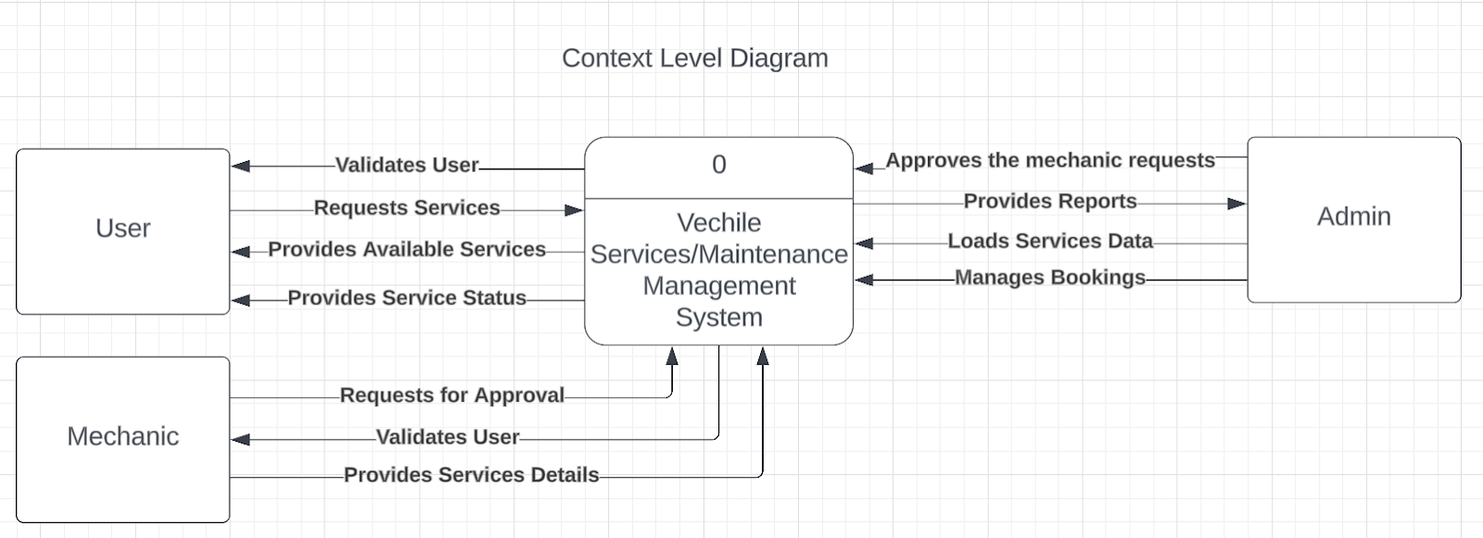
Context level

Slide 8
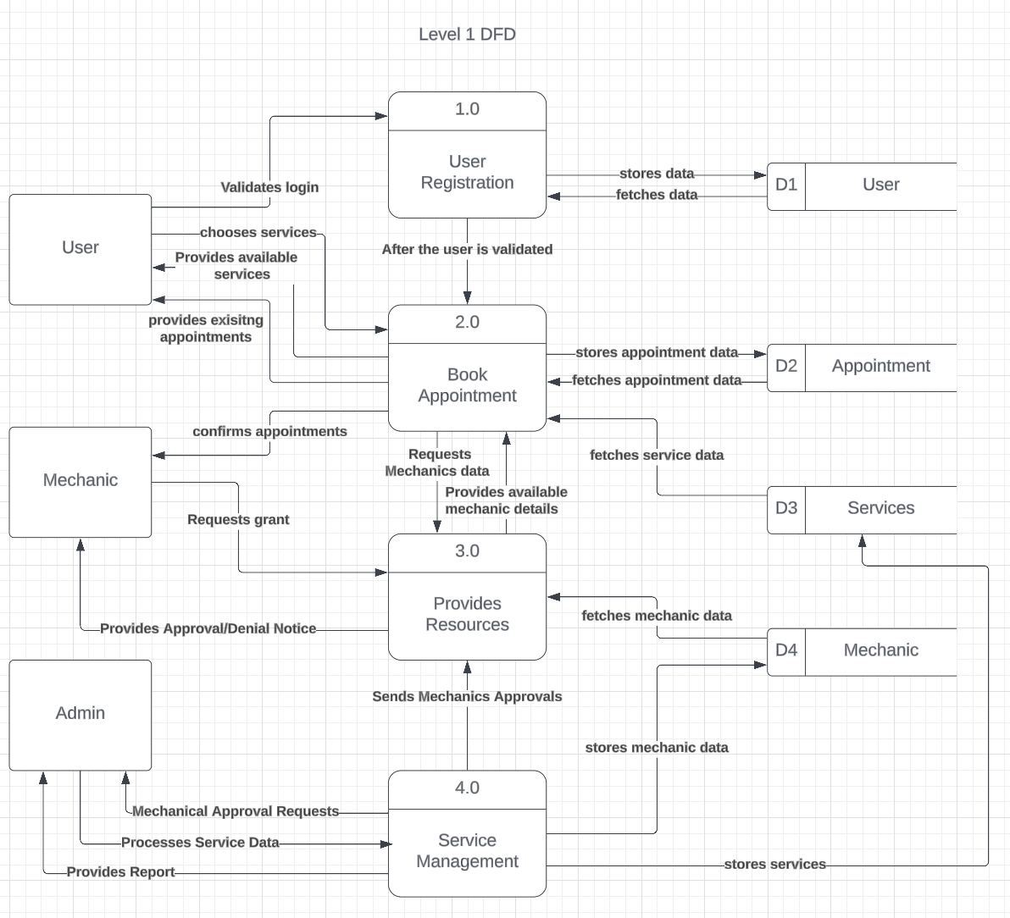
Level 0 DFD

Slide 9
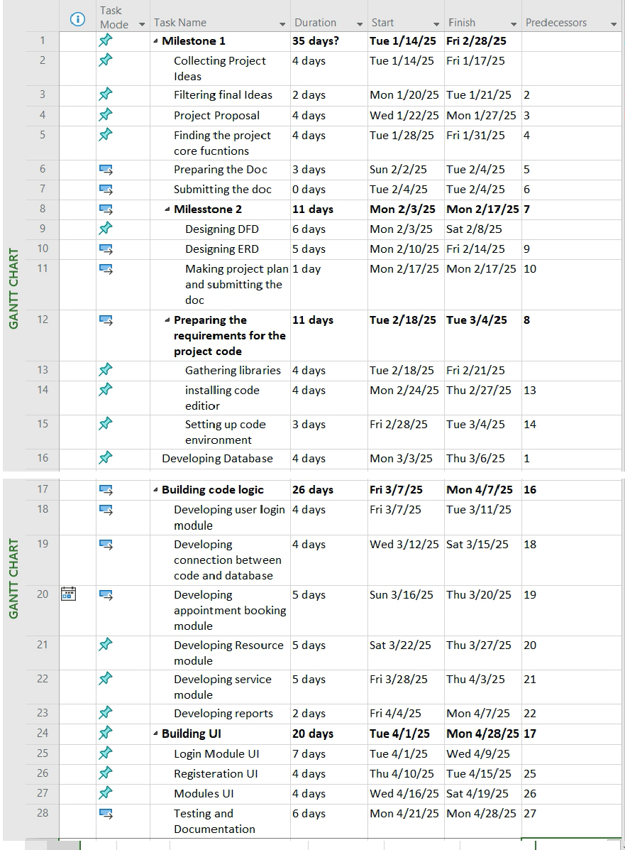
Task list

Slide 10
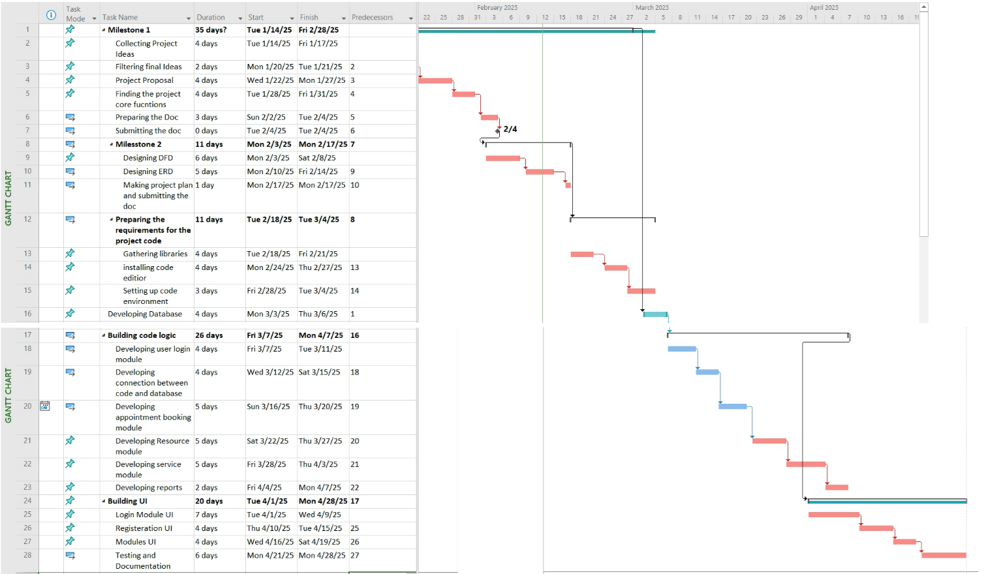
Critical path

Slide 11

Thank you

